Slide 1

Automated Visual Maze Solver Using Backtracking
by-
SARANSH UPADHYAY

Slide 2
SCOPE OF THE PROBLEM
A Maze is given as N*M binary matrix of blocks and there is a rat initially at (0, 0) ie. maze[0][0] and the rat wants to eat food which is present at some given block in the maze (fx, fy). In a maze matrix, 0 means that the block is a dead end and 1 means that the block can be used in the path from source to destination.
The rat can move in any direction (not diagonally) to any block provided the block is not a dead end. The task is to check if there exists any path so that the rat can reach the food or not.

Slide 3
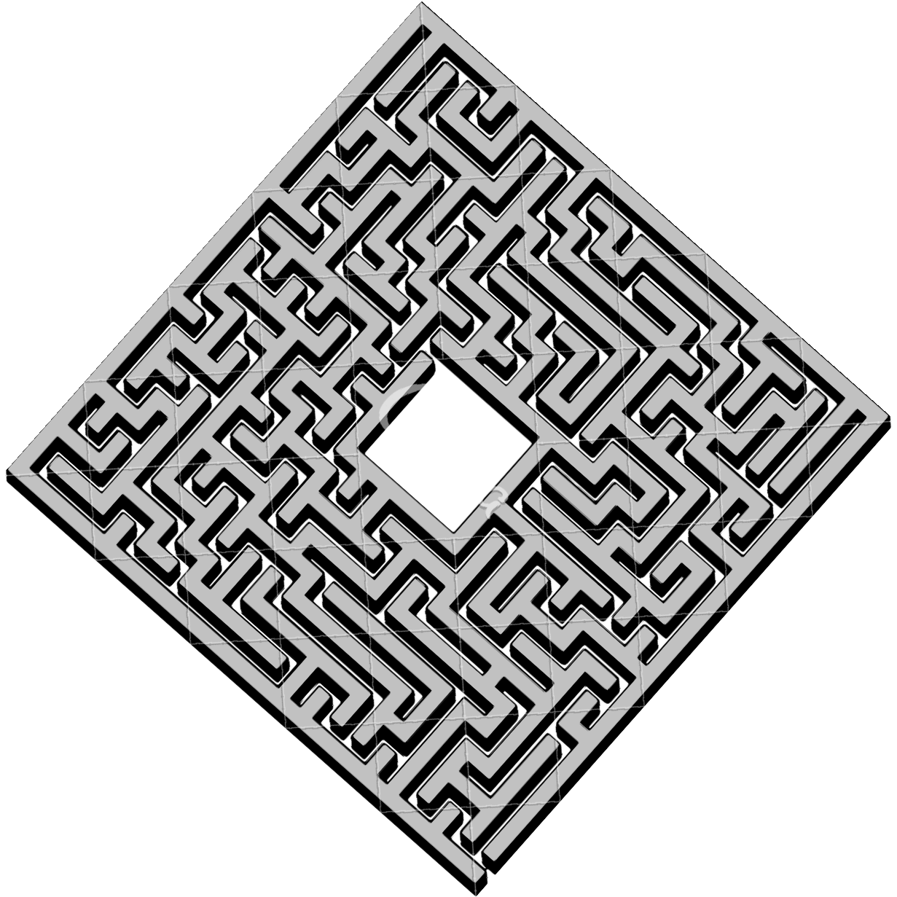
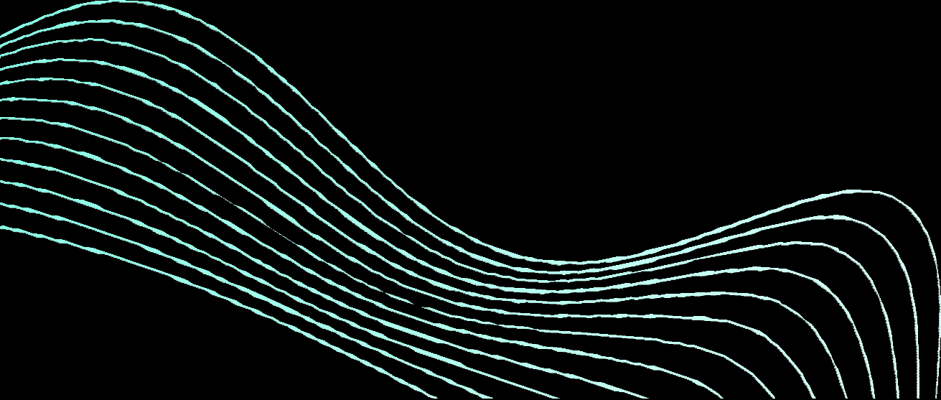
SCOPE OF THE PROBLEM
A maze is in the form of a 2D matrix in which some cells/blocks are blocked. One of the cells is termed as a source cell, from where we have to start. And another one of them is termed as a destination cell, where we have to reach. We have to find a path from the source to the destination without moving into any of the blocked cell.

Slide 4
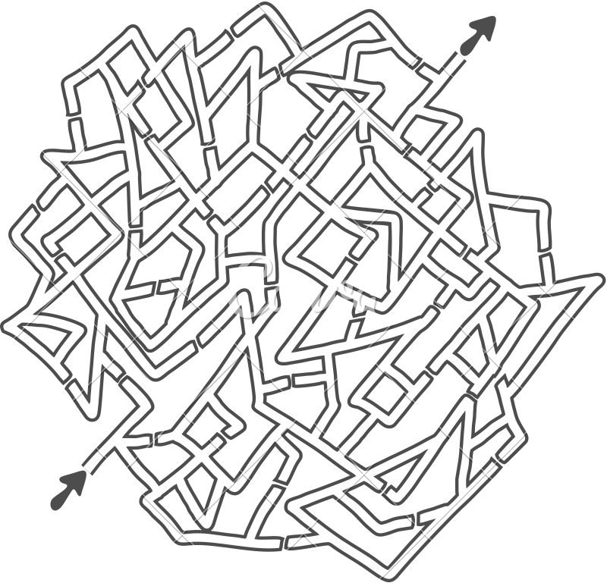
DATA STRUCTURES TO BE USED
2 D ARRAY
BACKTRACKING ALGORITHM RECURSION
STACK

Slide 5

Thank You

